Slide 1
Efficient Generation of Inductive Validity Cores (IVCs)
Elaheh Ghassabani, Andrew Gacek, Michael Whalen
University of Minnesota
Rockwell Collins Advanced Technology Center

Slide 2
Problem
Why is my property valid?
We need a formal explanation for the validity of the proof:
Inductive Validity Core (IVC):
works with inductive proof methods (like K-induction)
…
property 1
property 2
…
…
model elements:
IVCs for property 1
IVCs for property 2
Notes:
Inductive Validity Core (IVC):
works with inductive-based proof methods (like K-induction)

Slide 3

IVCs
property 1
property 2
A set of IVCs for a given property:
a minimal set of model elements necessary to construct an
inductive proof for the property
…
…
model elements:
IVCs for property 1
IVCs for property 2
Notes:
In other words, this method allows to relate each property to the design elements that the validity of the property is dependent on

Slide 4
Why do we care?
IVCs help to assess the quality of the specification and model in many ways
Automated traceability
Requirements completeness
Vacuity detection
Explanation of inconsistency
Reason for failure in symbolic simulation/ test case generation
property
…
…
model elements
IVCs
Notes:
Traceability: Describes which portions of the model are necessary for a proof. Also can be used to check for semantic vacuity.
Construct traceability matrices directly from proofs: sound and accurate matrices without manual effort
Depending on structure of “models” can be used to construct matrices between high / low-level requirements, low-level requirements to Simulink models or code.
Completeness Checking: Given a system contract, are all expressions within the model necessary for some proof?
In other words: do we have enough requirements?
Property completeness been a problem area for use of formal methods in critical development efforts. Much more efficient than previous approaches.
Proof Explanation: Why is a fact provable?
For Simulation: why is it not possible to take a “step”?
For Test Case Generation: why is there no test case for this obligation?

Slide 5
Set of IVCs
Given transition system (I, T) & safety property P
S ⊆ T is an IVC set iff (I, S) ⊦ P
S is minimal iff
(¬ ∃ S’ . S’ ⊂ S ∧ (I, S’) ⊦ P
s.t. (I, T) ⊦ P
P
S
T
T is a conjunction of a collection of terms: T = ⋀j Tj
Notes:
In order to talk about generalizing a transition system, we assume the transition relation of the system has the structure of a toplevel
conjunction. This assumption gives us a structure that we can easily manipulate as we generalize the system
By further abuse of notation we will identify $T$ with the set of its top-level conjuncts. Thus we will write $x \in T$ to mean that $x$ is a top-level conjunct of $T$. We will write $S \subseteq T$ to mean that all top-level conjuncts of $S$ are top-level
conjuncts of $T$.

Slide 6
How?
Based on UNSAT Cores in SMT Solvers
(I, T)
NOT property
...
solver
UNSAT cores
prop holds:
UNSAT
prop is violated :
SAT
Notes:
Generalization of work on UNSAT Cores in SMT Solvers for Inductive Proofs
Alloy uses UNSAT Cores for similar purposes
We extend this idea to inductive proofs and this allows additional uses.
Iterated use of UNSAT Core Algorithm
Find satisfying assignment for the Boolean formula
Claims = expressions within the model.
For AGREE, these are any equations or properties defined within the contracts.

Slide 7
General Idea
property
…
lemmas (invariants)
…
…
model elements
…
IVCs

Slide 8
Algorithm
get the invariants & mark them
property
get UNSAT cores
minimize the cores
…
mark model elements in TR
lemmas
construct a special query (IVC query)
get UNSAT cores
…
minimize the cores
model
elements
…

Slide 9
Minimality
Is it possible to compute “truly” minimal IVC sets?
YES with a brute force approach, but expensive
Our algorithm is a lot faster than the brute force approach
it yields “nearly” minimal IVC sets.
property
proof paths
…
Using
lemmas 1, i
IVC:
{x, y, z}
Using
lemmas 2, i
IVC:
{y, z}
1
2
i
lemmas
…
m
model elements
…
x
y
z
⊇

Slide 10
Implementation
Implemented in the JKind model checker:
symbolic model checking using induction-based techniques: IC3/PDR and k-induction.
such tools can often determine whether safety properties hold of complex finite or infinite-state systems.
Integrated in AGREE/AADL tool suite:
allows a model-based approach to system construction in which compositional proofs are used to automatically establish satisfaction arguments.

Slide 11
Research Questions
Goal: Determine quality of our approach and future directions
RQ1: Minimality
RQ2: Performance
RQ3: Diversity
how close to minimal is computed set?
does choice of solving algorithm (PDR, K-induction) matter?
overhead ?
how efficient is it in comparison with the brute force algorithm?
how do different solvers perform on computing IVCs?
how many different minimal IVC sets are there for a proof?
how similar are these IVC sets?

Slide 12
Experiments
Model set:
Valid set: 476 models have valid properties (necessary for IVC computation)
Machine: Intel(R) Core(TM) i5-2430M CPU @ 2.40GHz + 4GB RAM
13 different runs for each model
12 runs for cross product of
Solvers: Z3, Yices, SMTInterpol, MathSAT
Proof Methods: k-induction, PDR, cooperative (both)
1 run for the brute-force algorithm
Notes:
In this study, we started from a suite of 700 Lustre models developed
as a benchmark suite for [21]. We augmented this suite
with 81 additional models from recent verification projects including
avionics and medical devices [4, 38]. Most of the benchmark
models from [21] are small (10kB or less, with 6-40 equations) and
contain a range of hardware benchmarks and software problems involving
counters. The additional models are much larger: around
80kB with over 300 equations. We added the new benchmarks to
better check the scalability for the tools, especially with respect
to the brute force algorithm. Each benchmark model has a single
property to analyze.
G. Hagen and C. Tinelli. Scaling up the formal verification of
lustre programs with smt-based techniques. In Formal
Methods in Computer-Aided Design, 2008. FMCAD ’08,

Slide 13

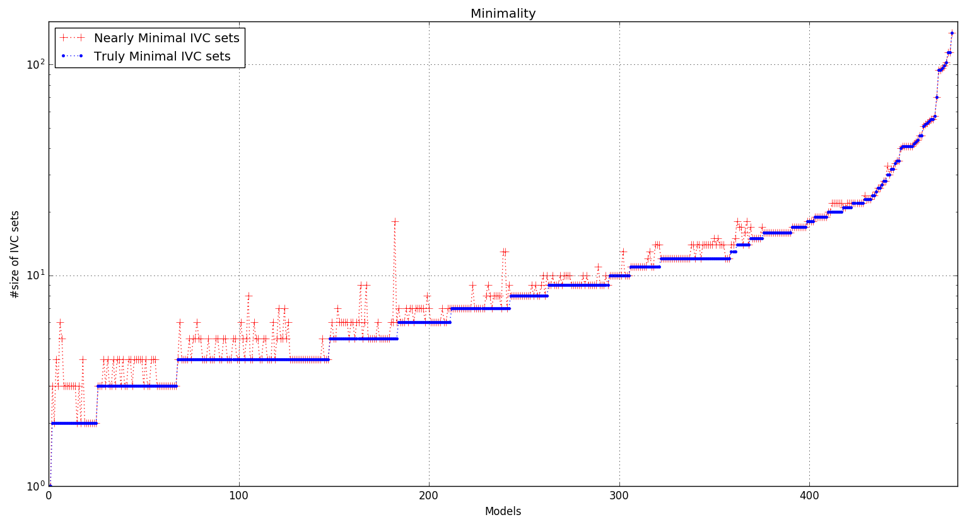
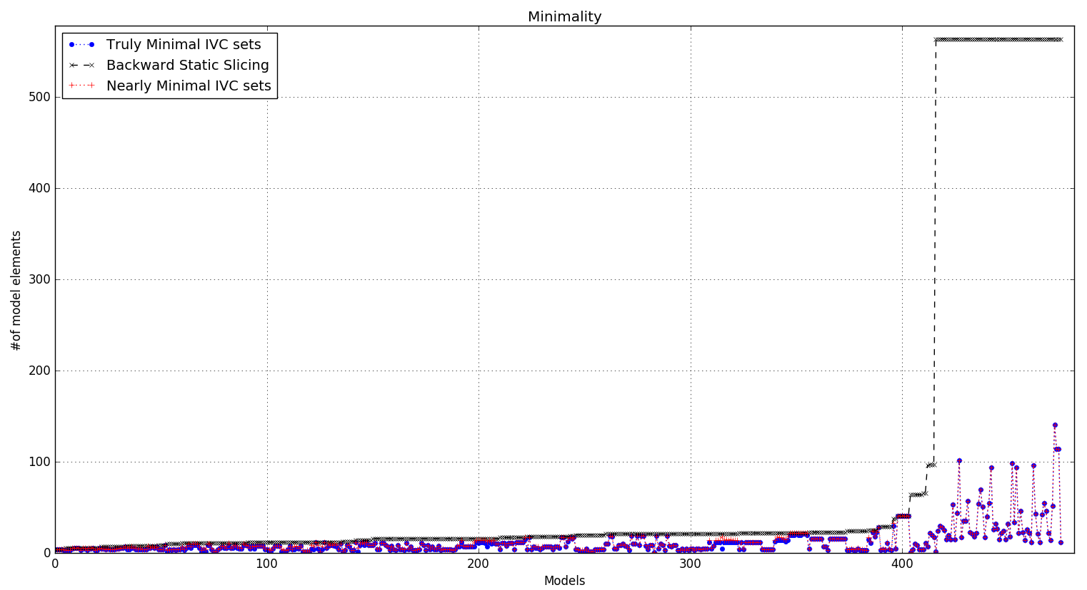
Minimality
in average, the size of the sets generated by our algorithm (nearly minimal sets) is 1.104 times bigger than truly minimal sets
Slices are (mean) 406% larger than nearly minimal IVCs

Slide 14
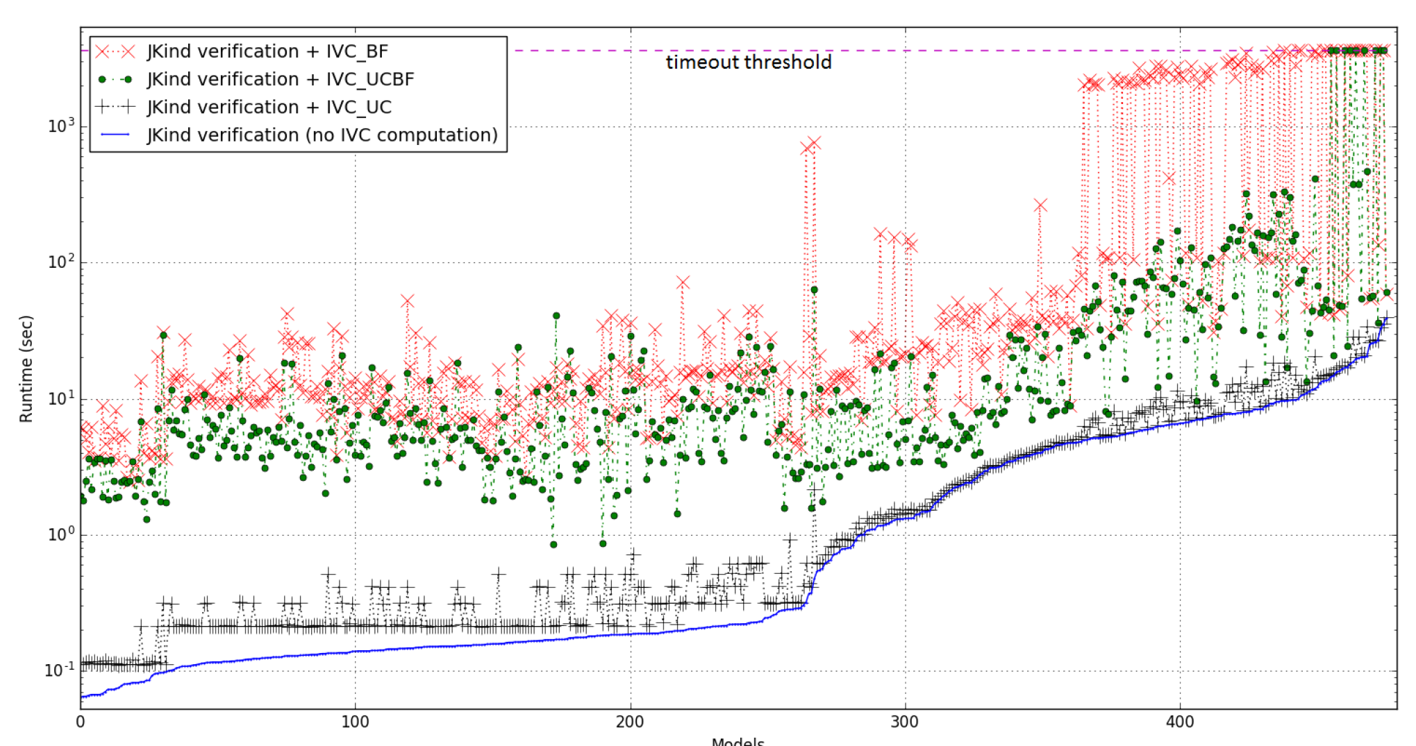
Performance

Slide 15
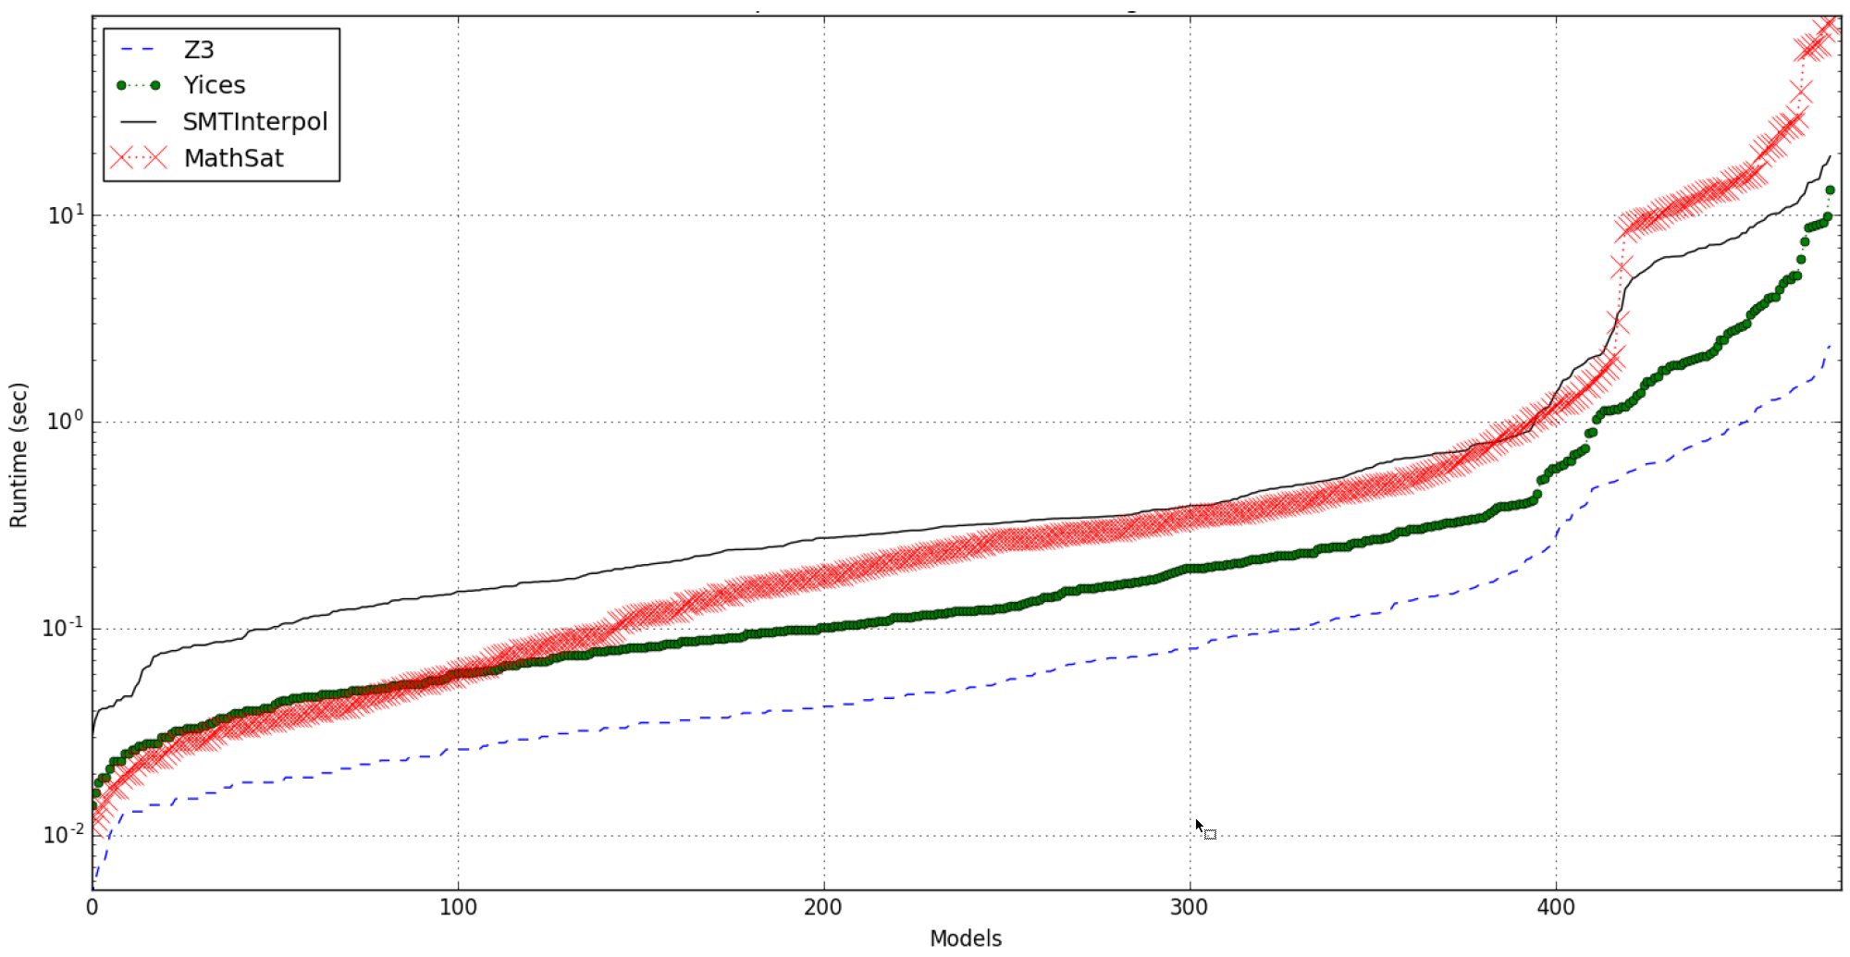
Solver Performance Impact

Slide 16
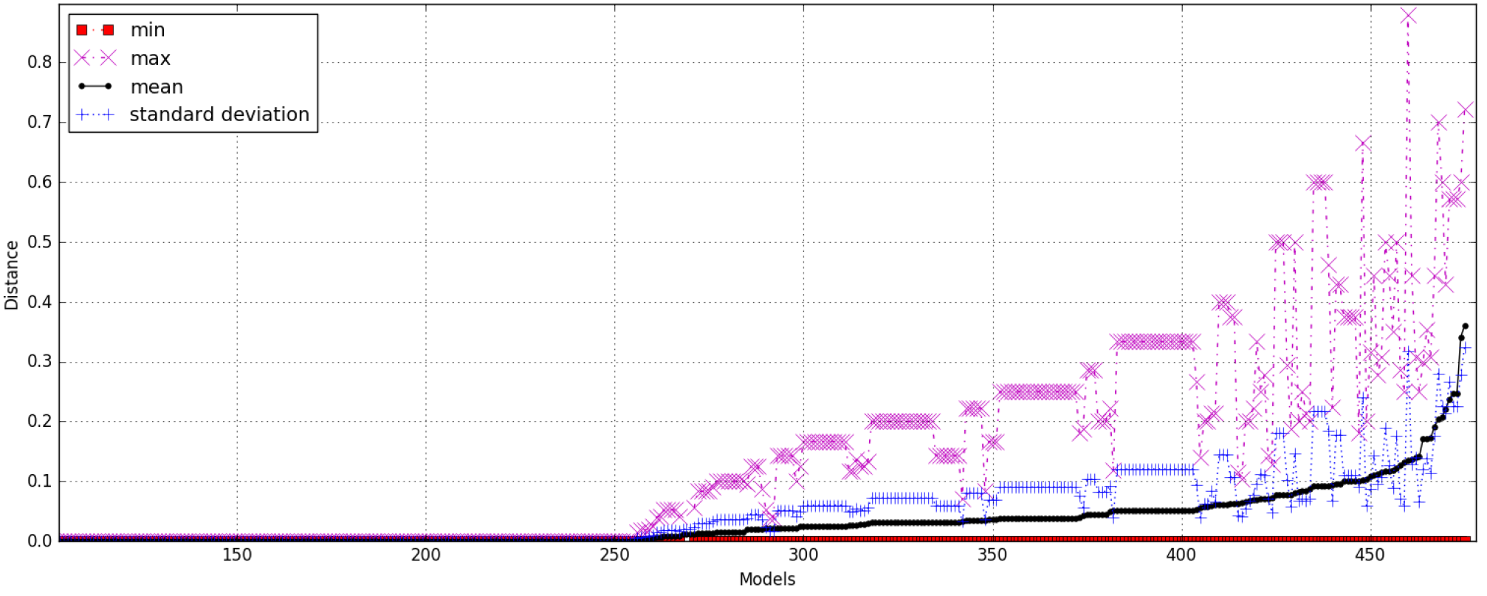


Diversity
How many different sets of IVCs are found by the solvers?
Problem involves distance between finite sets.
Usually measured with Jaccard distance:
B
i
j
c
J (A, B) = $\frac{|A ∩ B|}{|A ∪ B|}$
f
dJ (A, B) = 1 – J (A, B)
a
h
b
g
e
d
A
Intuitively:
If no overlap, distance (dJ) = 1
If sets are equal, distance (dJ) = 0
|A $∩$ B| = 1
|A $∪$ B| = 10
dJ (A, B) = 1 – 1/10= 0.9

Slide 17
Practical?! Useful?!
NASA CVFCS on the Quad-redundant flight controller
Rockwell Collins, part of the AFRL SpEAR project
Helicopter architecture proofs in the DARPA HACMS project
NSF Medical device project on the GPCA model
AGREE Symbolic Simulator, Part of DARPA SOSITE project
AGREE/JKind Test-Case Generator
Since Jan, 2016

Slide 18


Conclusion
improve change impact assessment
Requirements
Engineering
Acceptance
Test
https://github.com/
elaghs/
Working/tree/master/ support/experiments
System
Design
System
Test
improve scope management
assess the quality of the system
Architectural
Design
Integration
Test
http://loonwerks.com/ tools/jkind.html
improve test coverage + reduce test cost
+ test case generation
Component Design
Unit Test
Code
Development
creating assurance arguments

Slide 19
Thank You!
?

Slide 20
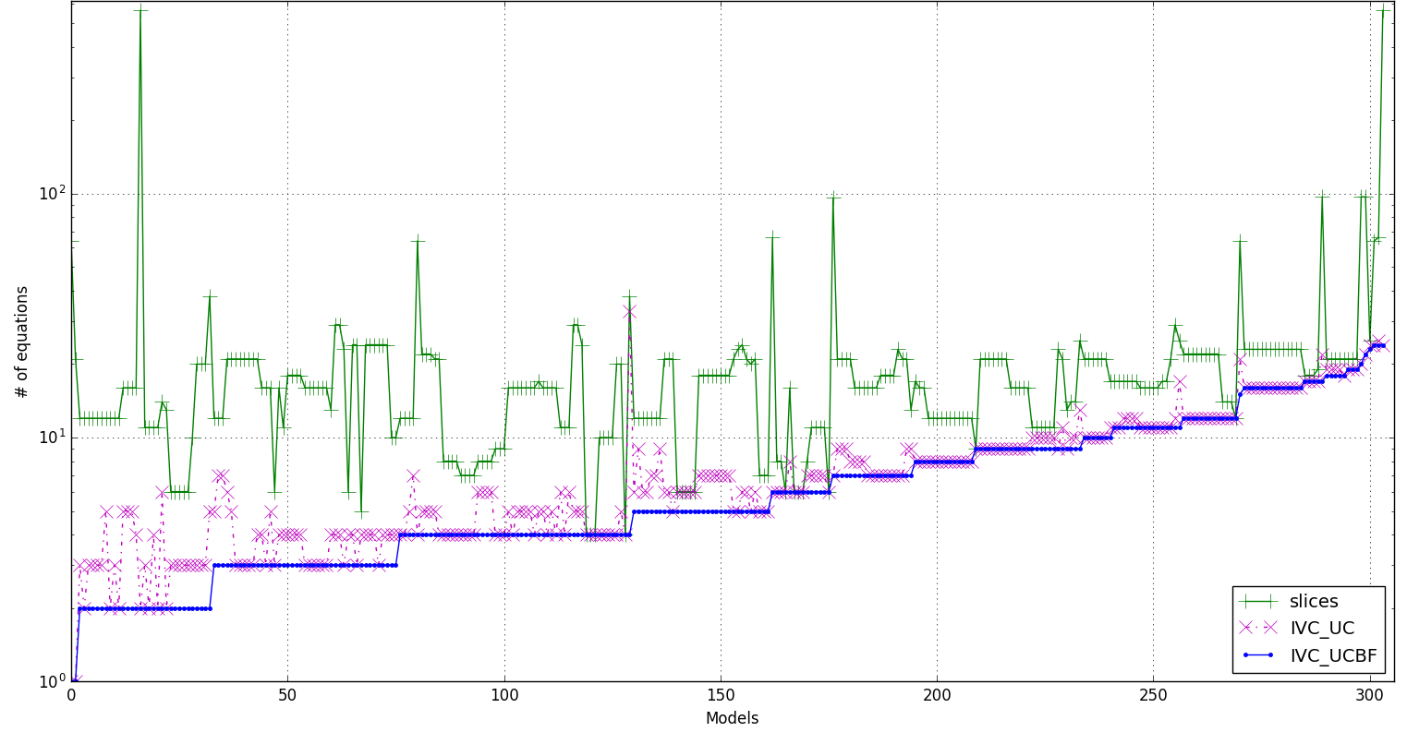
Minimality

Slide 21
Computing IVC Set
For each property:
Reduce invariants and find a minimal set of invariants
Obtain a minimum K by which the property is inductively provable
For the obtained K, compute unsat core with a special IVC query
Unsat core will contain a super-set of IVCs
Minimize unsat core to get a minimal set of IVCs

Slide 22
IVC Query
A combined query for given K:
(assert not ((base query) and (inductive query)))
We wanted to compute the support set with a single query (includes both base case & inductive step)
Idea is to use the base and inductive query at the same time
For a given K, suppose T (%init, VK-1, VK)
Usual base query at K = 0 :
(assert T (true, V-1, V0) )
(assert not P0)
Usual inductive query at K = 0 :
(assert T (%init, V-1, V0) )
(assert not P0)
Usual base/ inductive query at step K > 0 with asserting T ( false, VK-1, VK) : (assert not PK))
(assert T (true, V-1, V0) )
if K = 0 then P0
if K = 1 then %init => (P0 and (T (false, V0, V1) => P1))
…
K = 0: not ( T (true, V-1, V0) => P0)
K = 1: not ( T (true, V-1, V0) =>
(P0 and (T (false, V0, V1) => P1))
K = 2: not ( T (true, V-1, V0) =>
(P0 and (T (false, V0, V1) =>
(P1 and (T (false, V1, V2) => P2 ) ) ) ))
…
K : not ( T (true, V-1, V0) and P0 and
T (false, V0, V1) and P1 and
… and
T (false, VK-1, VK) => PK)
K : not ( T (true, V-1, V0) and P0 and
T (false, V0, V1) and P1 and
… and
T (false, VK-1, VK) => PK)

Slide 23
Set of IVCs?
portion of the model by which the proof was stablished
proof 3
proof 1
h
property P
e
a
d
…
k
i
g
b
n
f
c
l
o
m
specification
j
…
proof 2
model

Slide 24
Overhead of different algorithms
Algorithm | min | max | avg | stdev
All_IVCs | 13.642% | 101034.61% | 2544.399% | 7764.159%
Minimization | 0.0% | 3646.154% | 26.560% | 181.579%
IVC_UC | 0.0% | 100.0% | 10.226% | 11.718%
IVC_UCBF | 14.092% | 11124.432% | 882.018% | 1512.071%
IVC_MUST | 13.731% | 10530.769% | 1081.099% | 1613.265%
* Overhead = ( running time of the algorithm )/ ( JKind verification time) x 100

Slide 25
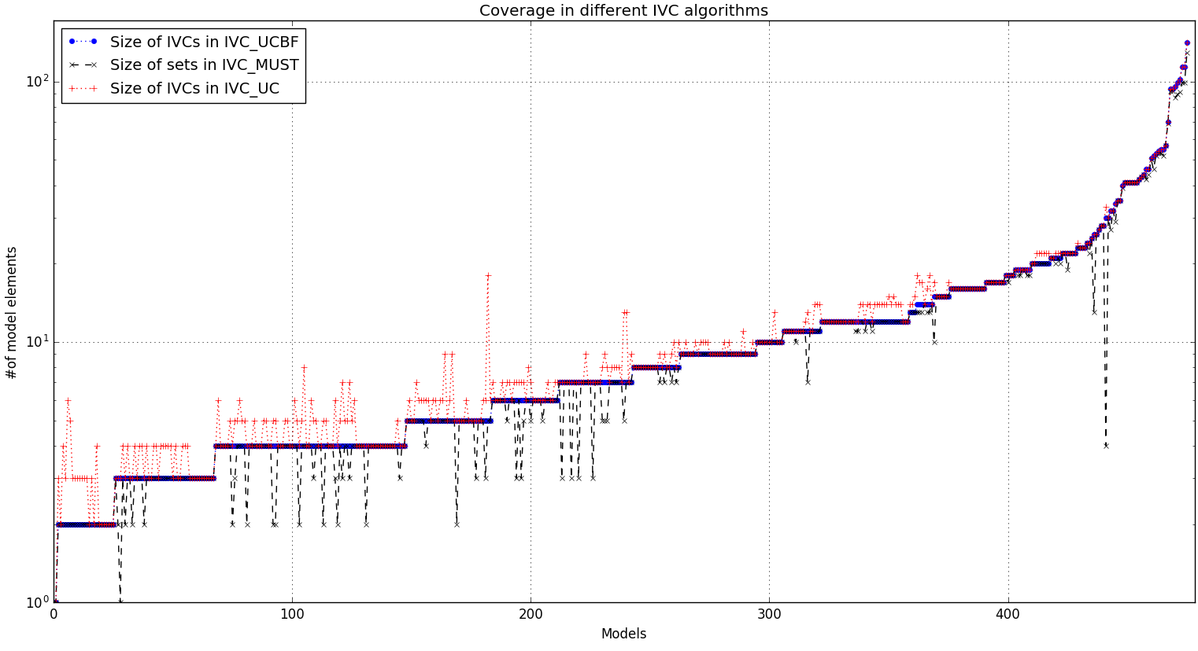
Coverage of different algorithms
IVC sizes | min | max | avg | stdev
IVC_UC | 1 | 141 | 12.741 | 15.986
IVC_UCBF | 1 | 141 | 12.174 | 16.092
IVC_MUST | 1 | 129 | 11.644 | 15.027
Ratio of IVC sizes | min | max | avg | stdev
IVC_UC to IVC_UCBF | 100% | 360% | 110.5% | 23.0%
IVC_MUST to IVC_UCBF | 13.3% | 100% | 95.9% | 12.1%
IVC_UC to IVC_MUST | 100% | 825% | 119.5% | 47.3%

Slide 26
Building Blocks
Source artifact (requirement or property) r ∈ ∆
Target artifacts (implementation or model elements) S ⊆ Σ
We write S ⊦s r for S ⊆ Σ and r ∈ ∆ when S satisfies requirement r
S is an IVC set
MIVC: a minimal set of target artifacts to construct a proof
maps a requirement to an IVC set
MIVC(r, s) ≡ s ⊦s r ∧ (¬ ∃ s0 . s0 ⊂ s ∧ s0 ⊦s r)

Slide 27
All IVCs
There could be many IVCs for a property: all IVC sets
MIVC(r, s) ≡ s ⊦s r ∧ (¬ ∃ s0 . s0 ⊂ s ∧ s0 ⊦s r)
AIVC (r) ≡ { s| s ⊆ Σ ∧ (r, s) ∈ MIVC }

Slide 28
Categorizing Design Artifacts
alarm
MUST (r) = ⋂ AIVC (r)
diff
MAY (r) = ( ⋃ AIVC (r)) \ MUST(r)
temp_below
hyst
heat_on
hyst
heat_on
IRR (r) = Σ\ ( ⋃ AIVC (r))
light

Slide 29
Coverage in Formal Verification
Have we specified enough requirements (properties)?
Justifiable notion of coverage:
given a property P = ⋀ pi ∈ ∆ and (P, S) ∈ MIVC, all element in S are covered
We could formalize complementary notions based on MIVC and AIVC
every property covers the elements in every (P, S) ∈ MIVC
given P = ⋀ pi ∈ ∆ , every element in AIVC (P) is covered
property P only covers elements in MUST (P)
…

Slide 30
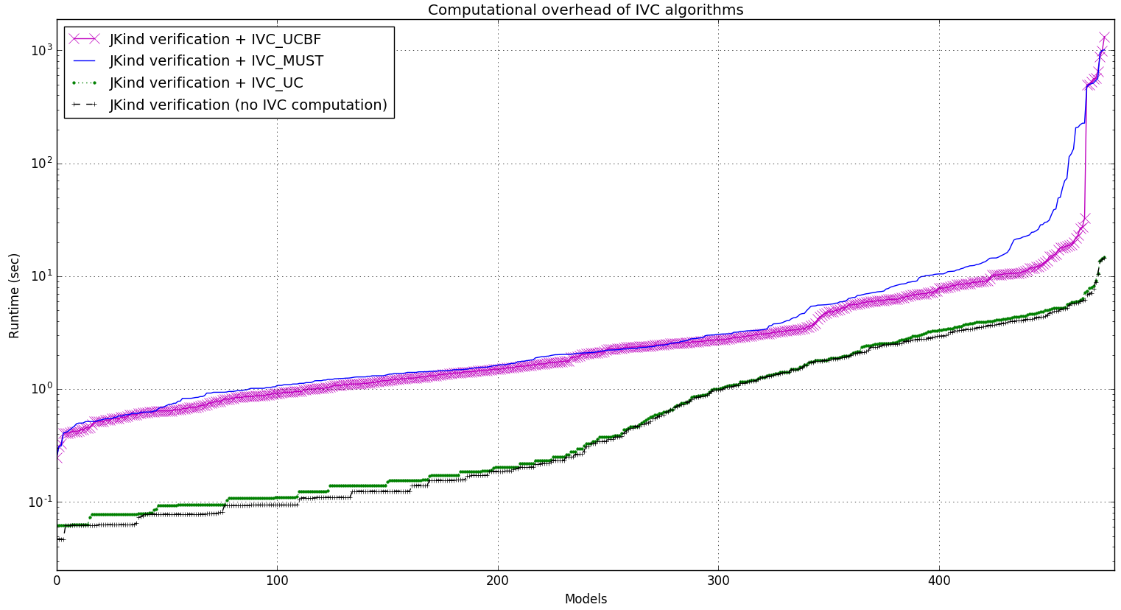
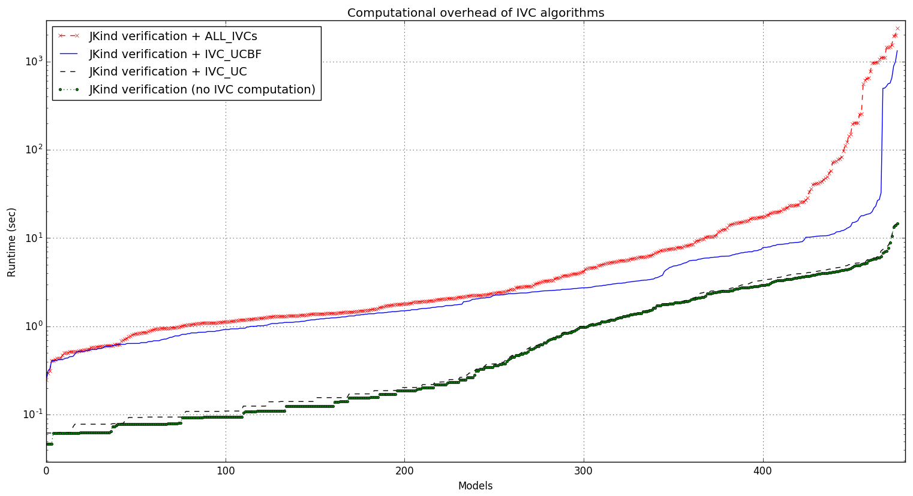
Overhead of different algorithms
Algorithm | min | max | avg | stdev
All_IVCs | 13.642% | 101034.61% | 2544.399% | 7764.159%
Minimization | 0.0% | 3646.154% | 26.560% | 181.579%
IVC_UC | 0.0% | 100.0% | 10.226% | 11.718%
IVC_UCBF | 14.092% | 11124.432% | 882.018% | 1512.071%
IVC_MUST | 13.731% | 10530.769% | 1081.099% | 1613.265%
* Overhead = ( running time of the algorithm )/ ( JKind verification time) x 100

Slide 31
